Slide 1


Study of Optimization Methods in Machine Learning
Optimization is the process where we train the model iteratively that results in a maximum and minimum function evaluation. It is one of the most important phenomena in Machine Learning to get better results.
Why do we optimize our machine learning models? We compare the results in every iteration by changing the hyperparameters in each step until we reach the optimum results. We create an accurate model with less error rate. There are different ways using which we can optimize a model.
Hitesh
A023119820027
5AI1

Slide 2

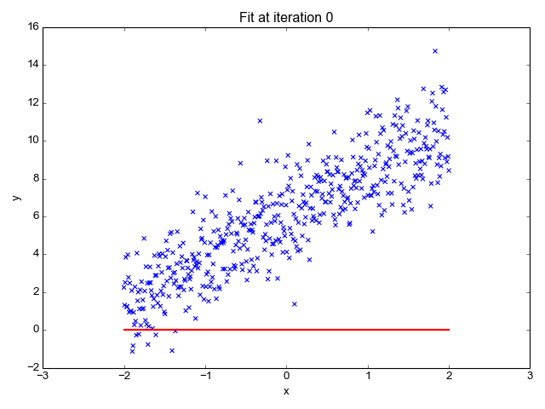
Linear Regression
Linear regression is used to study the linear relationship between a dependent variable (y) and one or more independent variables (X).

Slide 3
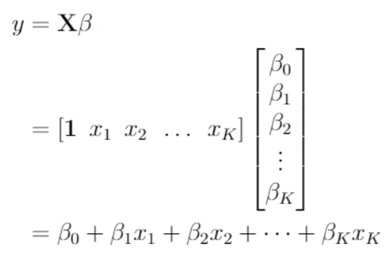
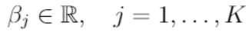
Linear Regression Model

Slide 4
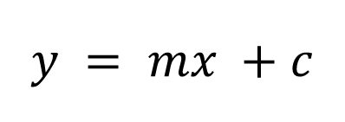
Modeling the dependent variable y_{i} with one independent variable x_{i}
where the subscript i refers to a particular observation (there are n data points in total). Here, β₀ and β₁ are the coefficients (or parameters) that need to be estimated from the data. β₀ is the intercept (a constant term) and β₁ is the gradient.
$$y = mx +c$$

Slide 5

Cost Function (MSE)
The cost is the variance from the value we projected. The cost will be determined using the Mean Squared Error function.
$$f\left(m,c\right) = \frac{1}{n}\sum_{i=1}^{n}{{\left(y_{i}−\left({mx}_{i }+c\right)\right)}^{2}}$$

Slide 6
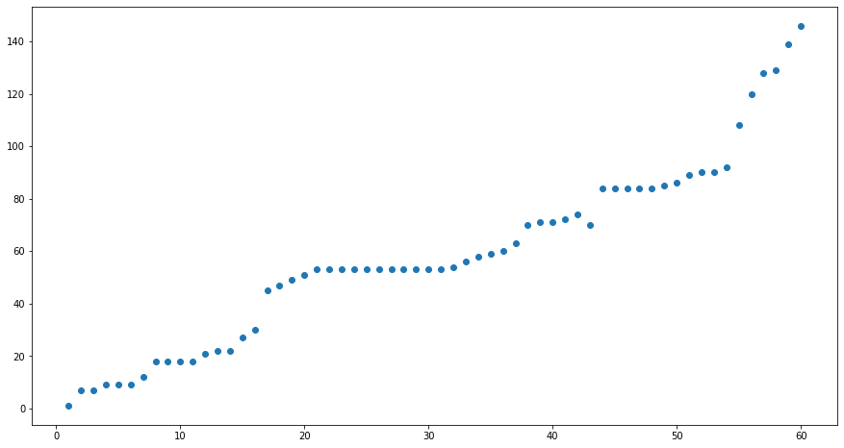
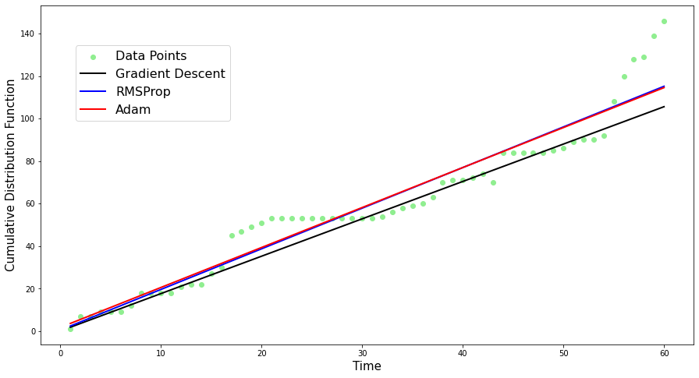
Instance

Slide 7
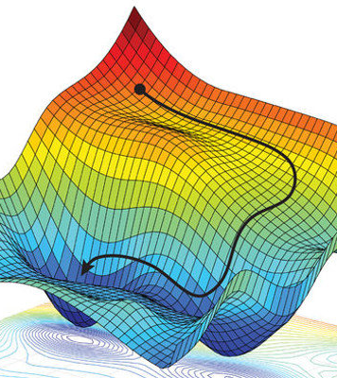
Gradient Descent Algorithm
Finding a local minimum or maximum of a given function is done using the iterative first-order optimization process known as gradient descent (GD). This technique is frequently used in machine learning (ML) and deep learning (DL) for the minimization of cost (error) function (e.g., in linear regression). This algorithm is typically taught in the fundamental stages of machine learning courses because of its significance and simplicity of implementation. However, it is frequently utilized in a variety of fields than ML/DL, including:

Slide 8
$$D_{m}=\frac{∂f}{∂m}=\frac{−2}{n}\sum_{i=1}^{n}{x_{i}\left(y_{i}−\left(mx_{i}+c\right)\right)}$$
𝐷_𝑚=𝜕𝑓/𝜕𝑚=(−2)/𝑛 ∑1_(𝑖=1)^𝑛▒〖𝑥_𝑖 (𝑦_𝑖−(𝑚𝑥_𝑖+𝑐)) 〗
$$m=m−α∗D_{m}$$
𝑚=𝑚−𝛼∗𝐷_𝑚
Partial
derivative
w.r.t. m
Update
Rule
$$D_{c}=\frac{∂f}{∂c}=\frac{−2}{n}\sum_{i=1}^{n}{\left(y_{i}−\left(mx_{i}+c\right)\right)}$$
𝐷_𝑐=𝜕𝑓/𝜕𝑐=(−2)/𝑛 ∑1_(𝑖=1)^𝑛▒(𝑦_𝑖−(𝑚𝑥_𝑖+𝑐))
$$c=c−α∗D_{c}$$
𝑐=𝑐−𝛼∗𝐷_𝑐
Partial
derivative
w.r.t. c
Update
Rule

Slide 9
RMSProp
Root Mean Squared Propagation, or RMSProp, is a variation on gradient descent and AdaGrad.
The decaying moving average feature of RMSProp overcomes the drawback of AdaGrad. This feature enables the algorithm to ignore early gradients and concentrate on the most recently recorded partial gradients detected as the search progresses.
This algorithm follows the procedure of gradient descent algorithm for choosing a function to minimize and letting some initial values for the parameters (m and c) of the function. Then, the partial derivatives for the cost function are evaluated with respect to each parameter.

Slide 10
$$υ_{t}^{(m)}=ρυ_{t−1}^{(m)}+{(1−ρ)(D_{m})}^{2}$$
𝜐_𝑡^((𝑚))=𝜌𝜐_(𝑡−1)^((𝑚))+〖(1−𝜌)(𝐷_𝑚)〗^2
$$m_{t+1}=m_{t}−\frac{∝}{\sqrt{\sum{υ_{t}^{(m)}}+ε}}∙D_{m}$$
𝑚_(𝑡+1)=𝑚_𝑡−∝/√(∑1▒𝜐_𝑡^((𝑚)) +𝜖)∙𝐷_𝑚
$$υ_{t}^{(c)}=ρυ_{t−1}^{(c)}+{(1−ρ)(D_{c})}^{2}$$
𝜐_𝑡^((𝑐))=𝜌𝜐_(𝑡−1)^((𝑐))+〖(1−𝜌)(𝐷_𝑐)〗^2
$$c_{t+1}=c_{t}−\frac{∝}{\sqrt{\sum{υ_{t}^{(c)}}+ε}}∙D_{c}$$
𝑐_(𝑡+1)=𝑐_𝑡−∝/√(∑1▒𝜐_𝑡^((𝑐)) +𝜖)∙𝐷_𝑐

Slide 11
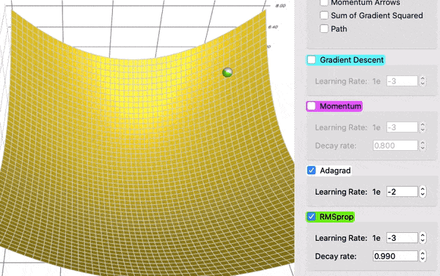

Slide 12
Adam
Adam, also known as the Adaptive Movement Estimation algorithm, is a variation on the gradient descent optimization process. Adam is intended to speed up the optimization process, for example, by reducing the number of function evaluations necessary to attain the optima, or to enhance the capabilities of the optimization algorithm, for instance, by producing a better outcome.
As an extension of gradient descent, Adam also follows the first two steps of the gradient descent algorithm as a pre-requisite before its execution: to identify the cost function and determine the initial values for parameters m (slope) and c (intercept).
Then, to find the gradients for the MSE by taking partial derivatives of the cost function with respect to each parameter.

Slide 13
$$μ_{t}^{m}=β_{1}∗μ_{(t−1)}^{m}+(1−β_{1})∗D_{m}$$
𝜇_𝑡^𝑚=𝛽_1∗𝜇_((𝑡−1))^𝑚+(1−𝛽_1)∗𝐷_𝑚
$$ν_{t}^{m}=β_{2}∗ν_{\left(t−1\right)}^{m}+\left(1−β_{2}\right)∗D_{m}^{2}$$
𝜈_𝑡^𝑚=𝛽_2∗𝜈_((𝑡−1))^𝑚+(1−𝛽_2 )∗𝐷_𝑚^2
$$m_{t}=m_{t−1}−\frac{α∗{\hat{μ}}_{t}^{m}}{\sqrt{{\hat{ν}}_{t}^{m}+ε}}$$
𝑚_𝑡=𝑚_(𝑡−1)−(𝛼∗𝜇 ̂_𝑡^𝑚)/√(𝜈 ̂_𝑡^𝑚+𝜀)
$$μ_{t}^{c}=β_{1}∗μ_{(t−1)}^{c}+(1−β_{1})∗D_{c}$$
𝜇_𝑡^𝑐=𝛽_1∗𝜇_((𝑡−1))^𝑐+(1−𝛽_1)∗𝐷_𝑐
$$ν_{t}^{c}=β_{2}∗ν_{(t−1)}^{c}+(1−β_{2})∗D_{c}^{2}$$
𝜈_𝑡^𝑐=𝛽_2∗𝜈_((𝑡−1))^𝑐+(1−𝛽_2)∗𝐷_𝑐^2
$$c_{t}=c_{t−1}−\frac{α∗{\hat{μ}}_{t}^{c}}{\sqrt{{\hat{ν}}_{t}^{c}+ε}}$$
𝑐_𝑡=𝑐_(𝑡−1)−(𝛼∗𝜇 ̂_𝑡^𝑐)/√(𝜈 ̂_𝑡^𝑐+𝜀)

Slide 14
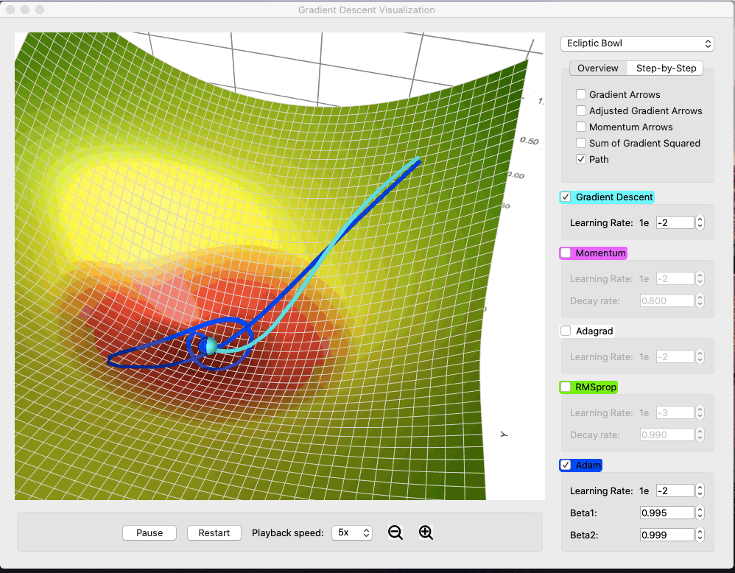

Slide 15
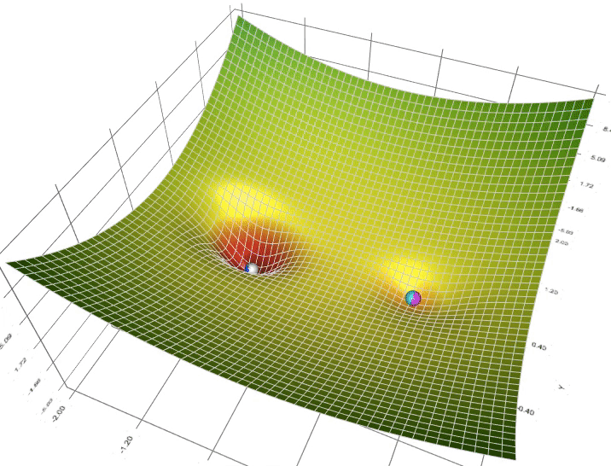
Visualization of Optimization Methods in Linear Regression
Animation of 5 gradient descent methods on a surface:
Gradient Descent (cyan)
Momentum (magenta)
AdaGrad (white)
RMSProp (green)
Adam (blue)
Left well is the global minimum; right well is a local minimum.

Slide 16

Applications of Optimization Methods and Regression Theory
Its use is not limited to ML/DL only, it’s being widely used also in areas like:
Control engineering (robotics, chemical, etc.)
Computer games
Mechanical engineering
Prediction and forecasting
Determine the price of a commodity, interest rates

Slide 17



THANK YOU

Slide 18
EMPLOYED DATASETS
There are three datasets used for the experimentation in this project work taken from different sources to do a diverse study by implementing optimization algorithms on different forms of datasets:
Web ERP System Dataset
Dataset 1 from a web-based integrated accounting ERP system (Web ERP) covering the period from August 2003 to July 2008, is the first historical defect data set [14]. This data set has been utilized extensively in several works, including [15], [16]. Table II contains the information, with the month as the temporal unit. In total, 146 defects have been found in the last 60 months.
Advertising Dataset
Dataset 2 provides statistical data for linear regression. [17] It provides analytical data for the sales from the advertising through different communication media, namely TV, radio, and newspaper.
Fishing Dataset
Dataset 3 lists the seven most popular fish species sold at fish markets. [18] With this dataset, a predictive model that uses machine-friendly data may be used to estimate fish weight. Dataset provides the study about the species, weight, lengths, height, and width of the fishes.

Slide 19
Update Rule for RMSProp
sum_of_gradient_squared = previous_sum_of_gradient_squared * decay_rate+ gradient² * (1- decay_rate)
delta = -learning_rate * gradient / sqrt(sum_of_gradient_squared)
theta += delta

Slide 20
Update Rule for ADAM
sum_of_gradient = previous_sum_of_gradient * beta1 + gradient * (1 - beta1) [Momentum]
sum_of_gradient_squared = previous_sum_of_gradient_squared * beta2 + gradient² * (1- beta2) [RMSProp]
delta = -learning_rate * sum_of_gradient / sqrt(sum_of_gradient_squared)
theta += delta

Slide 21
Ordinary Least Squares (OLS)
Obtaining reliable estimators of the coefficients so that we can investigate the relationships among the variables of interest.
derive estimates on the intercept and slope that minimize the sum of squared residuals (SSR).
Minimizing the SSR is a desired result, since we want the error between the regression function and sample data to be as small as possible.
The coefficient estimates that minimize the SSR are called the Ordinary Least Squared (OLS) estimates

Slide 22
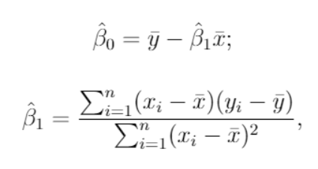
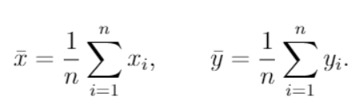
The OLS coefficient estimates for the simple linear regression are as follows:
Where the “hats” above the coefficients indicate that it concerns the coefficient estimates
And the “bars” above the x and y variables mean that they are the sample averages, which are computed as

